Slide 1
Digital Signal Processing LTI System
Abu saleh Musa Miah
Lecturer, Dept. of CSE, BAUST, Bangladesh email: musa@baust.edu.bd, tel: +88-01727-786600 web: www.baust.edu.bd/cse

Slide 2
Define LTI system?
The digital signal processing is concerned exclusively with a particular class of system known as linear time invariant system.
In LTI systems the output is the convolution between the input signal and system impulse response.
convolution is a mathematical operator which takes two functions f and g and produces a third function that in a sense represents the amount of overlap between f and a reversed and translated version of g.
to set as input to any LTI system any arbitrary signal is need to be decomposed and represented as in weighted sum of unit sample sequences.
We will learn that multiplication in frequency domaing is equivalent of convolution in time domain

Slide 3
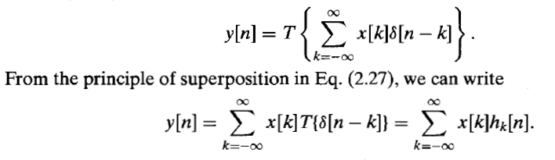
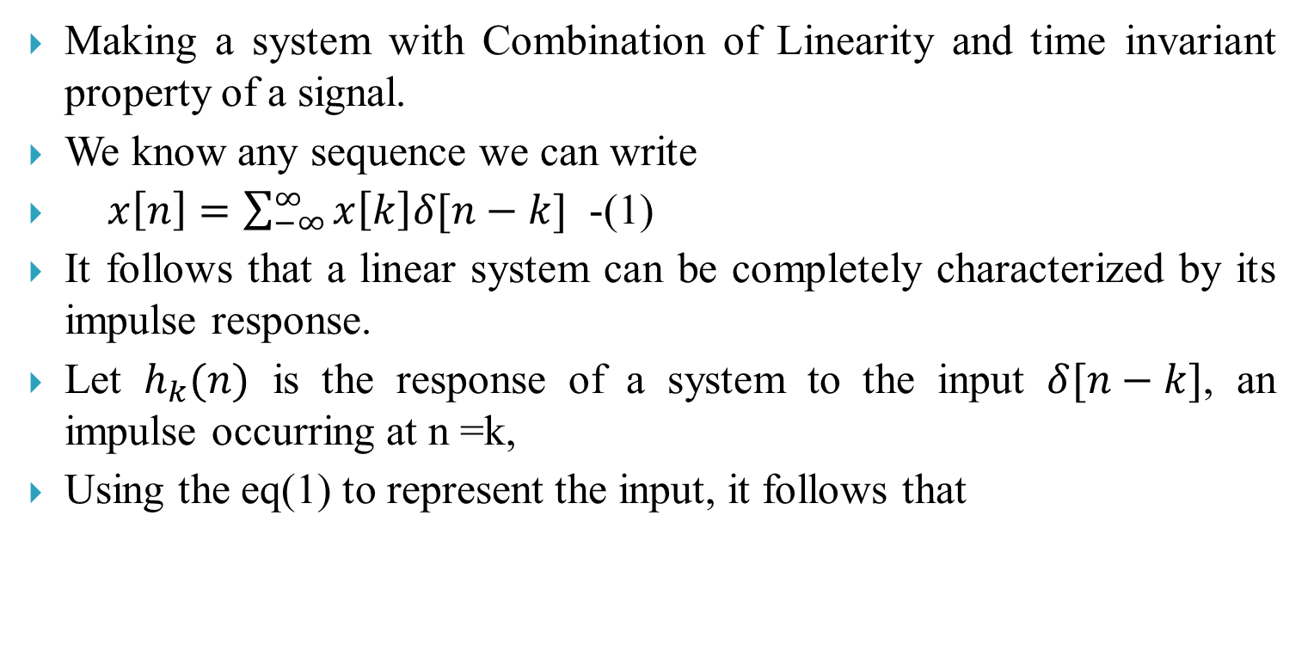

Define LTI system?
Making a system with Combination of Linearity and time invariant property of a signal.
We know any sequence we can write
$x\left[n\right]=\sum_{−∞}^{∞}{x\left[k\right]δ[n−k]}$ -(1)
It follows that a linear system can be completely characterized by its impulse response.
Let $h_{k}(n)$ is the response of a system to the input $δ[n−k]$, an impulse occurring at n =k,
Using the eq(1) to represent the input, it follows that
…(2)
If only linearity is imposed then $h_{k}(n)$ depend both n and k

Slide 4
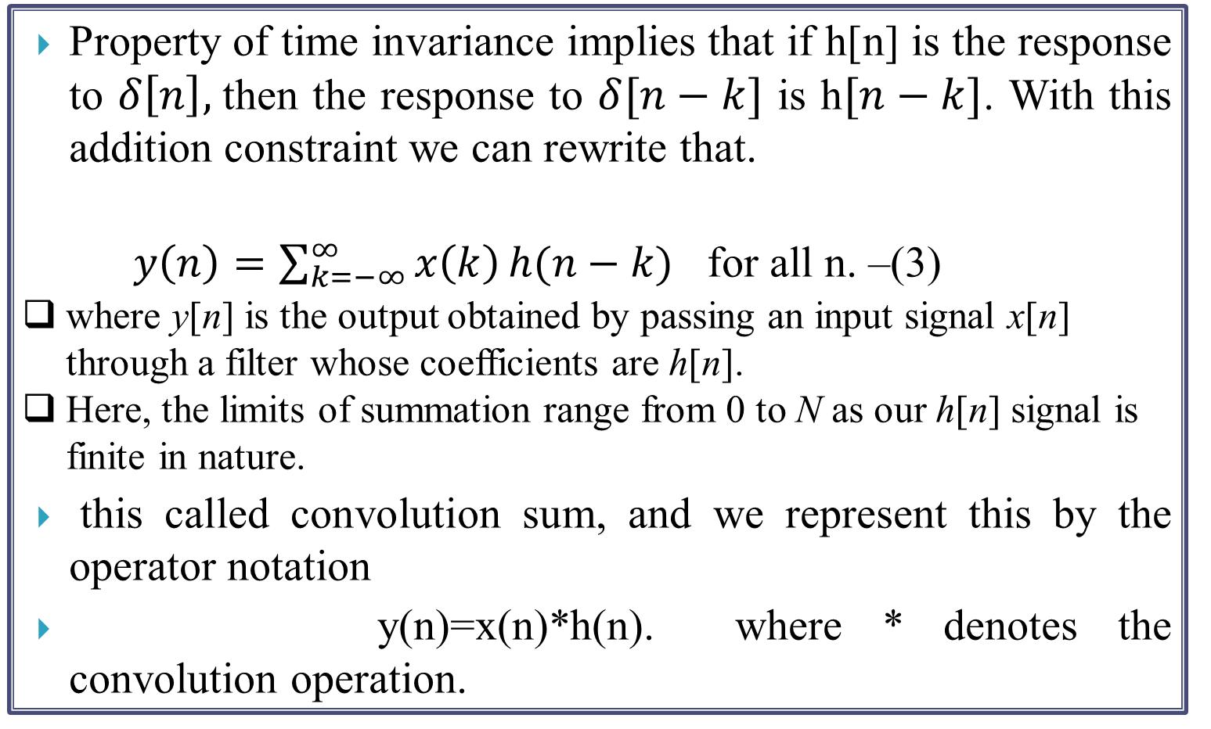
Define convolution sum?
Property of time invariance implies that if h[n] is the response to $δ\left[n\right],$then the response to $δ[n−k]$ is h$[n−k]$. With this addition constraint we can rewrite that.
$y\left(n\right)=\sum_{k=−∞}^{∞}{x\left(k\right)}h(n−k)$ for all n. –(3)
where y[n] is the output obtained by passing an input signal x[n] through a filter whose coefficients are h[n].
Here, the limits of summation range from 0 to N as our h[n] signal is finite in nature.
this called convolution sum, and we represent this by the operator notation
y(n)=x(n)*h(n). where * denotes the convolution operation.

Slide 5
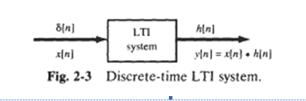

Slide 6
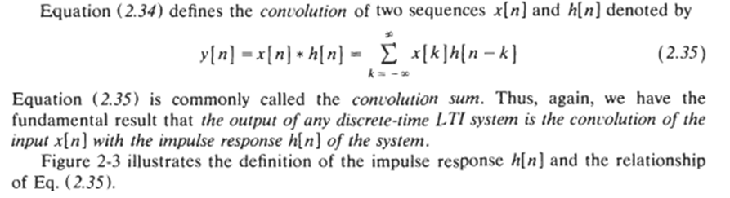
Convolution Sum

Slide 7
LTI
Our first observation is that the index in the summation is k, and hence both the input signal x(k) and the impulse response h(no - k ) are functions of k.
Second, we observe that the sequences x(k) and h(no - k) are multiplied together to form a product sequence. The output y(na) is simply the sum over all values of the product sequence.
The sequence h(no - k) is obtained from h(k) by, first, folding h(k) about k = 0 (the time origin), which results in the sequence h(- k). The folded sequence is then shifted by no to yieid h(no - k ) .
To summarize, the process of computing the convolution between x ( k ) and h(k) involves the following four steps.

Slide 8
Three different process of computing convolution sum?
Mathematical approach
Tabular approach
Graphical approach

Slide 9
Mathmatical Aproach
Let length of sequence x(n) is N1,
lower limit of x(n) is n1,upper limit of x(n) is n2.
length of sequence h(n) is N2,
lower limit of x(n) is p1, upper limit of x(n) is p2.
(a)Let length of sequence y(n) is :-
length of sequence x(n) is
+ length of sequence h(n) is -1
n=N1+N2-1
(b) lower limit of y(n) is :-
lower limit of x(n) is + lower limit of h(n) is
y(n)=n1+p1
(c) upper limit of y(n) is :-
upper limit of x(n) is + upper limit of h(n) is
y(n)=n2+p2

Slide 10
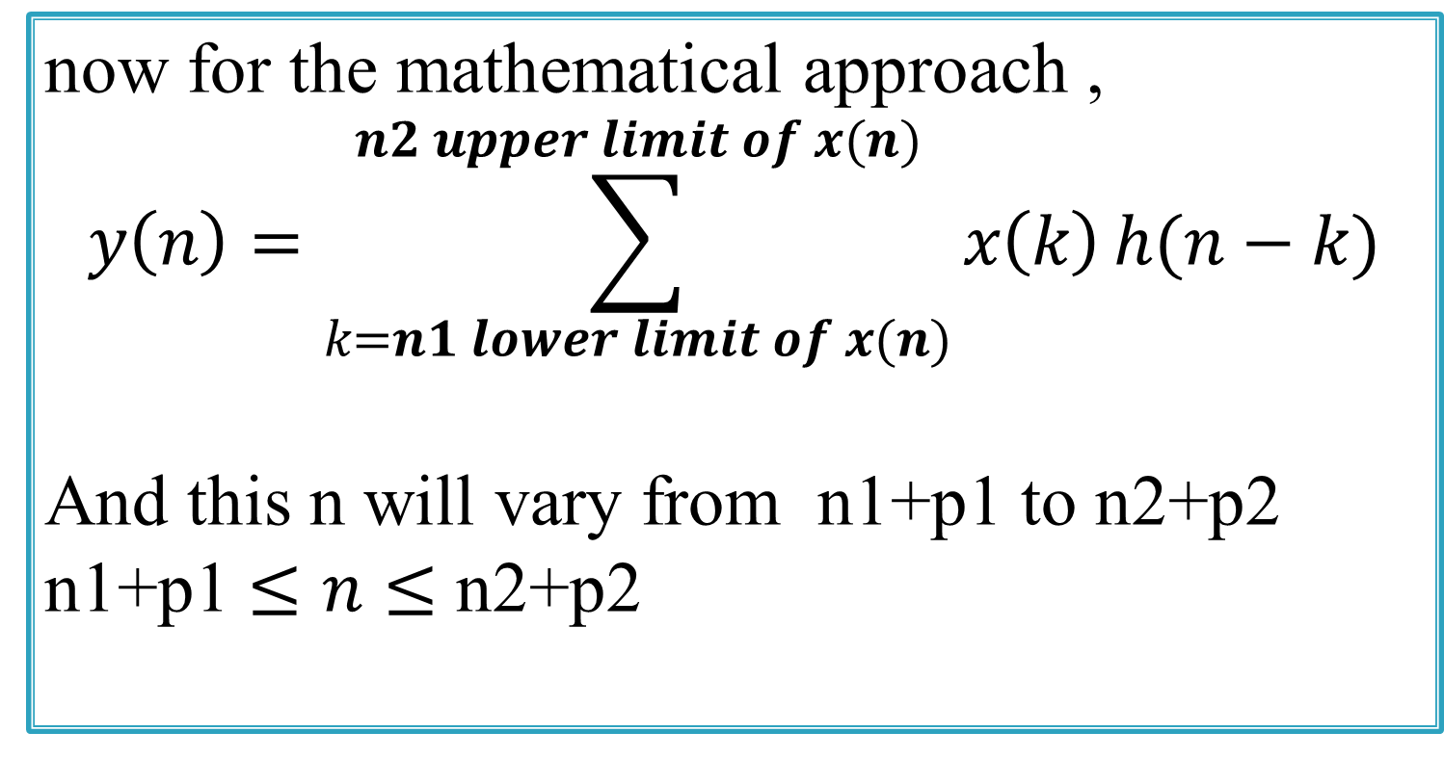
Mathmatical Aproach
now for the mathematical approach ,
$$y\left(n\right)=\sum_{k=n1 lower limit of x(n)}^{n2 upper limit of x(n)}{x\left(k\right)}h(n−k)$$
And this n will vary from n1+p1 to n2+p2
n1+p1 $≤n≤$ n2+p2

Slide 11
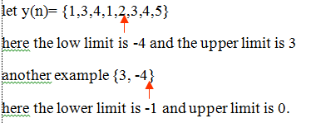
Mathmatical Aproach
Try to understand upper limit and lower limit

Slide 12
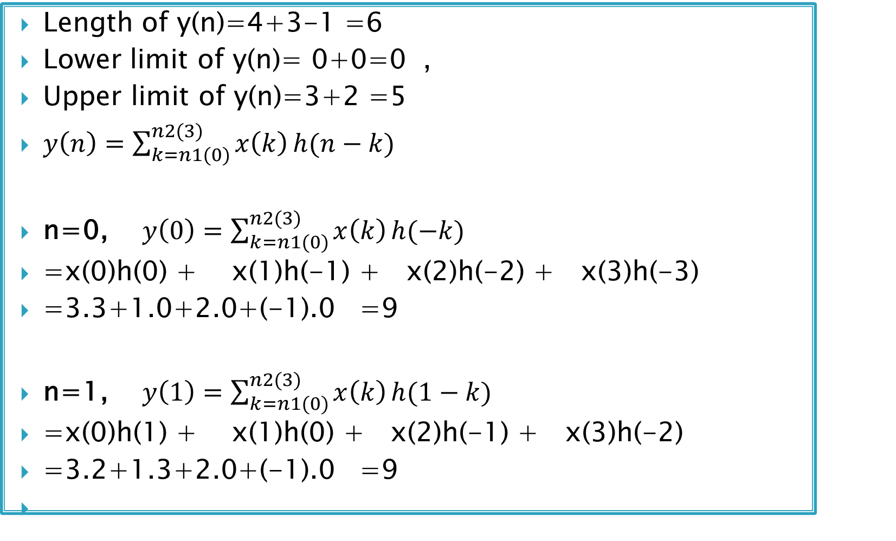
the input sequence x(n)={3^,1,2,-1} sequence is applied to discrete time processor with unit sample response h(n)={3^,2,1}
Length of y(n)=4+3-1 =6
Lower limit of y(n)= 0+0=0 ,
Upper limit of y(n)=3+2 =5
$y\left(n\right)=\sum_{k=n1(0)}^{n2(3)}{x\left(k\right)}h(n−k)$
n=0, $y\left(0\right)=\sum_{k=n1(0)}^{n2(3)}{x\left(k\right)}h(−k)$
=x(0)h(0) + x(1)h(-1) + x(2)h(-2) + x(3)h(-3)
=3.3+1.0+2.0+(-1).0 =9
n=1, $y\left(1\right)=\sum_{k=n1(0)}^{n2(3)}{x\left(k\right)}h(1−k)$
=x(0)h(1) + x(1)h(0) + x(2)h(-1) + x(3)h(-2)
=3.2+1.3+2.0+(-1).0 =9

Slide 13
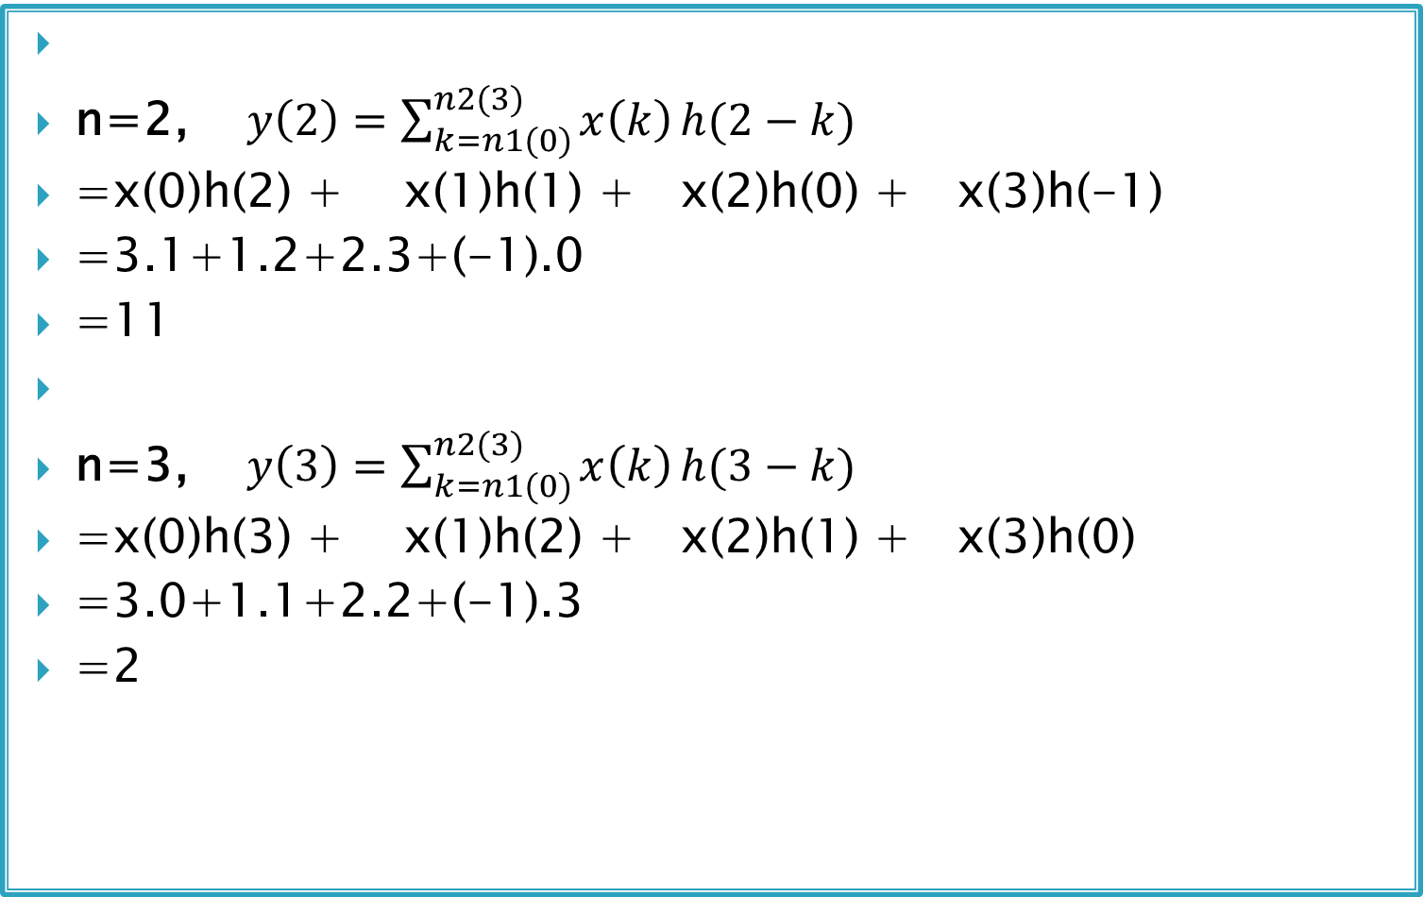
the input sequence x(n)={3^,1,2,-1} sequence is applied to discrete time processor with unit sample response h(n)={3^,2,1}
n=2, $y\left(2\right)=\sum_{k=n1(0)}^{n2(3)}{x\left(k\right)}h(2−k)$
=x(0)h(2) + x(1)h(1) + x(2)h(0) + x(3)h(-1)
=3.1+1.2+2.3+(-1).0
=11
n=3, $y\left(3\right)=\sum_{k=n1(0)}^{n2(3)}{x\left(k\right)}h(3−k)$
=x(0)h(3) + x(1)h(2) + x(2)h(1) + x(3)h(0)
=3.0+1.1+2.2+(-1).3
=2

Slide 14
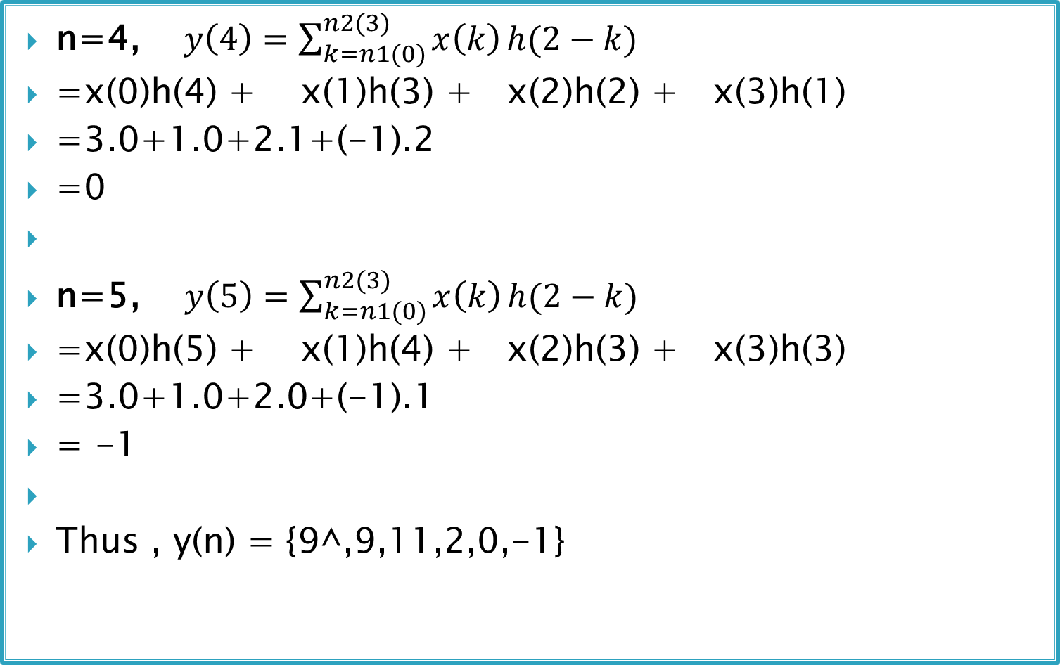
the input sequence x(n)={3^,1,2,-1} sequence is applied to discrete time processor with unit sample response h(n)={3^,2,1}
n=4, $y\left(4\right)=\sum_{k=n1(0)}^{n2(3)}{x\left(k\right)}h(2−k)$
=x(0)h(4) + x(1)h(3) + x(2)h(2) + x(3)h(1)
=3.0+1.0+2.1+(-1).2
=0
n=5, $y\left(5\right)=\sum_{k=n1(0)}^{n2(3)}{x\left(k\right)}h(2−k)$
=x(0)h(5) + x(1)h(4) + x(2)h(3) + x(3)h(3)
=3.0+1.0+2.0+(-1).1
= -1
Thus , y(n) = {9^,9,11,2,0,-1}

Slide 15
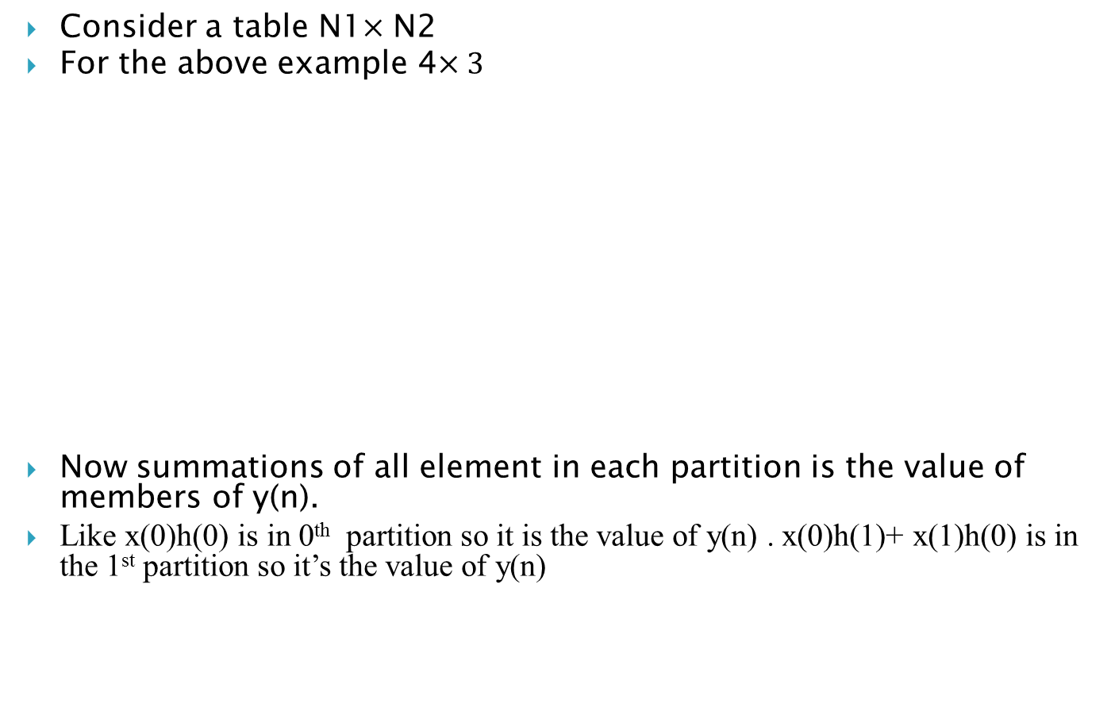
Tabular approach:-
Consider a table N1$×$ N2
For the above example 4$×3$
Now summations of all element in each partition is the value of members of y(n).
Like x(0)h(0) is in 0th partition so it is the value of y(n) . x(0)h(1)+ x(1)h(0) is in the 1st partition so it’s the value of y(n)
 | h(0) | h(1) | h(2)
x(0) | x(0)h(0) | x(0)h(1) | x(0)h(2)
x(1) | x(1)h(0) | x(1)h(1) | x(1)h(2)
x(2) | x(2)h(0) | x(2)h(1) | x(2)h(2)
x(3) | x(3)h(0) | x(3)h(1) | x(3)h(2)

Slide 16
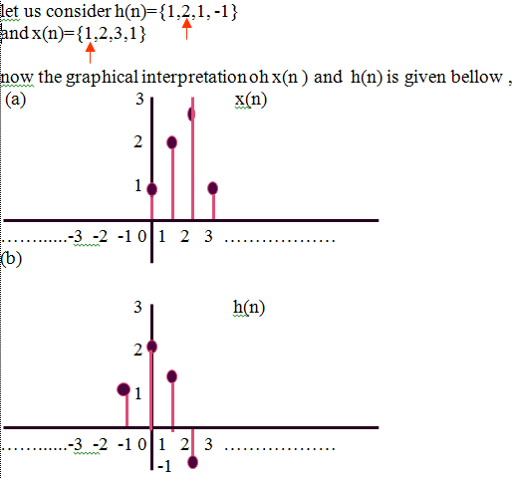
Graphical Approach

Slide 17
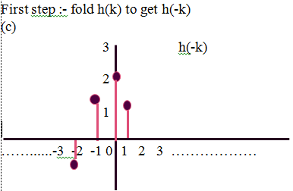
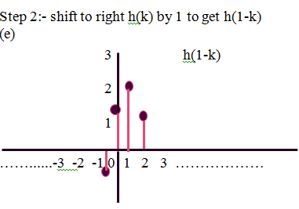
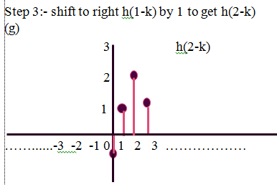
Graphical Approach
Similarly we can find y(3)=3 ,y(4)= -2 , y(5) =- 1,as the upper bound is 2+3 = 5 so we will stop here. and as the lower bound is 0+(-1) = -1 we have to find y (-1).
For that we have to shift h(-k) to left by 1 position to get h(-1-k)

Slide 18
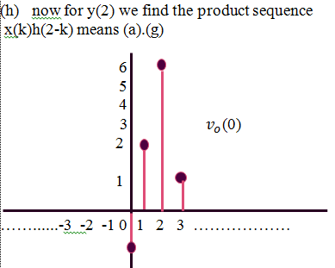
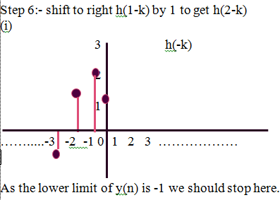
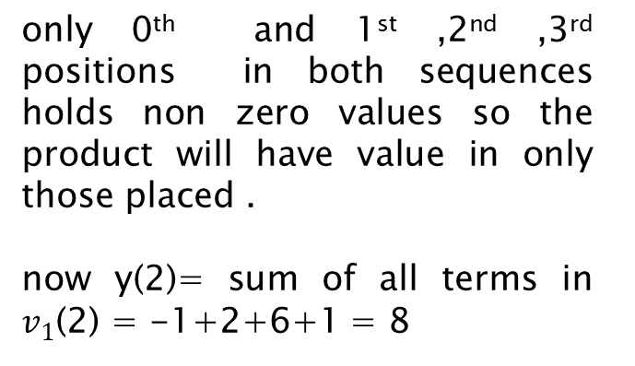
Graphical Approach
only 0th and 1st ,2nd ,3rd positions in both sequences holds non zero values so the product will have value in only those placed .
now y(2)= sum of all terms in $v_{1}$(2) = -1+2+6+1 = 8

Slide 19
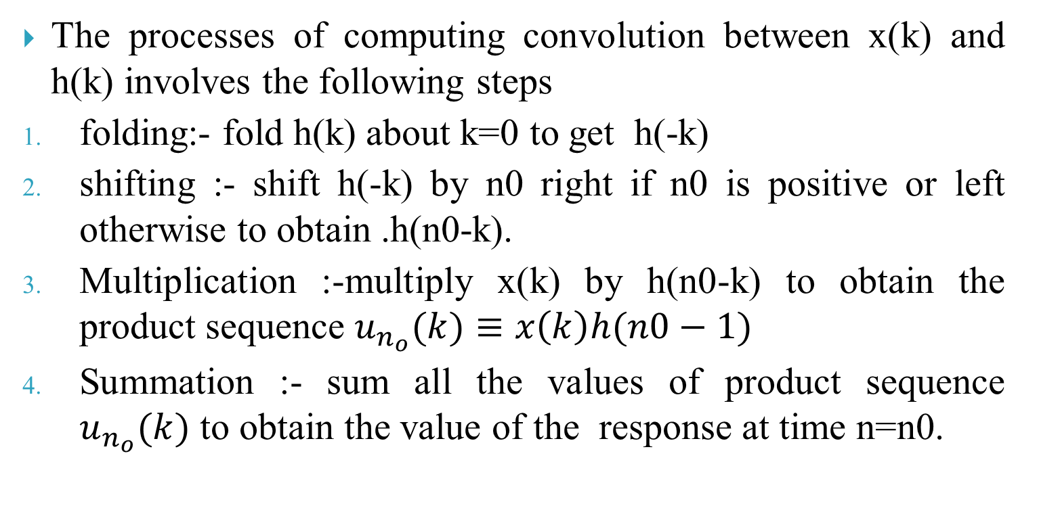
process of computing convolution sum?
The processes of computing convolution between x(k) and h(k) involves the following steps
folding:- fold h(k) about k=0 to get h(-k)
shifting :- shift h(-k) by n0 right if n0 is positive or left otherwise to obtain .h(n0-k).
Multiplication :-multiply x(k) by h(n0-k) to obtain the product sequence $u_{n_{o}}(k)≡x\left(k\right)h(n0−1)$
Summation :- sum all the values of product sequence $u_{n_{o}}(k)$ to obtain the value of the response at time n=n0.

Slide 20
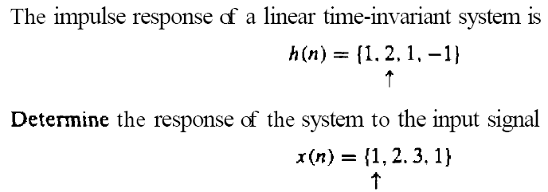
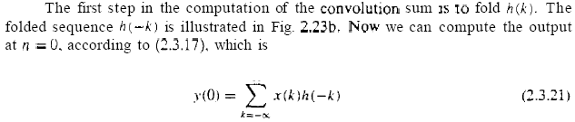
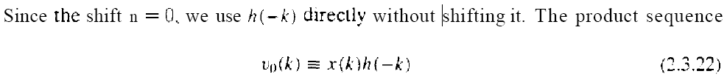
Example:

Slide 21
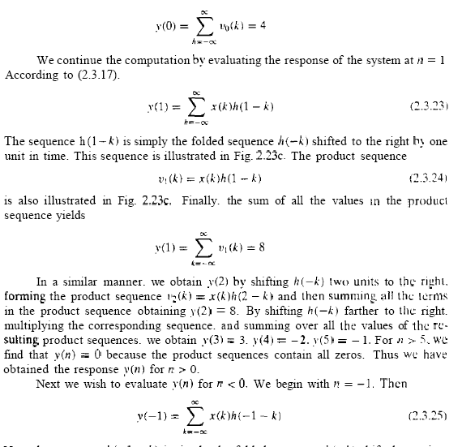
Example:

Slide 22
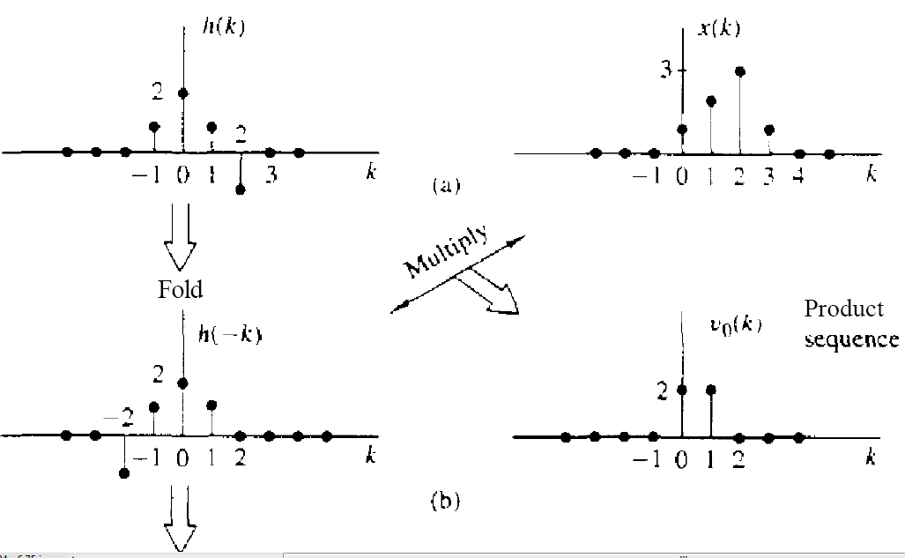
Example:

Slide 23
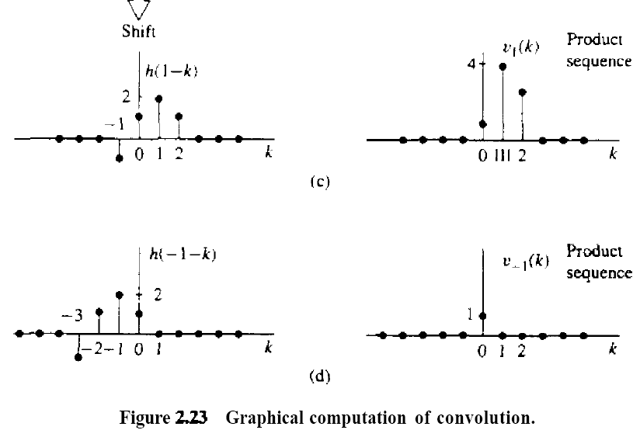
Example:

Slide 24
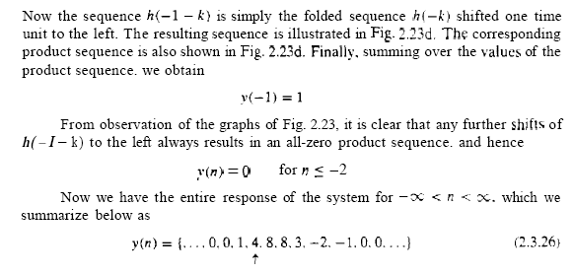
Example:

Slide 25
Example:
Consider the input x[n] = {2, 3, 4} of a LTI system and impulse response h[n] = {2, 1}. Find out the convolution sum of output y[n] of the LTI system.
Solution:
Given,
The input of the LTI system, x[n] = {2, 3, 4}
The impulse response h[n] = {2, 1}.
Form the convolution sum theorem, the order of the index of impulse response will de changed as h[-n] = {1, 2}.

Slide 26
Now the convolution sum output will be computed using the equation
Now, we compute, y(0), y(1), y(2), y(3), y(4), ......

Slide 32
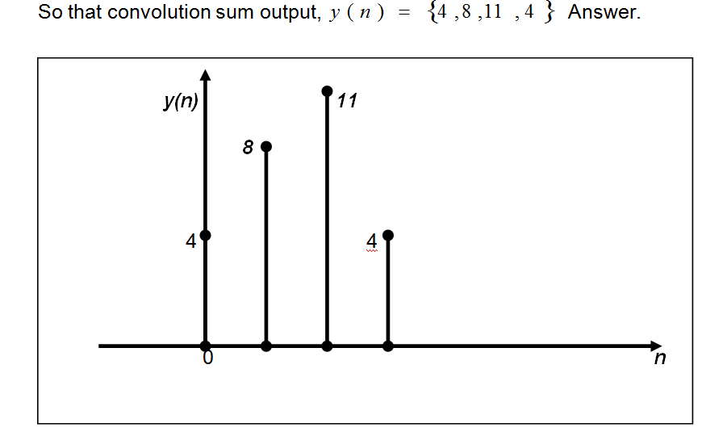
Figure: Output, y(n):

Slide 33
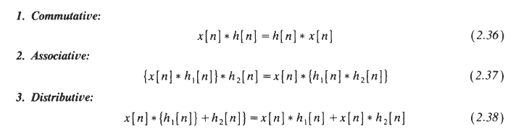
Properties of the convolution sum:

Slide 34

properties of convolution sum?
Commutative :-
The convolution operation is Commutative,
x(n)*h(n)= h(n)*x(n)
proof:
from the definition of convolution ,
$y\left(n\right)=\sum_{k=−∞}^{∞}{x\left(k\right)}h(n−k)$
let ( n- k)=p , now as $k→∞ so p →−∞ and as$
$k→−∞ so p →∞ and$ .
$$x\left(n\right)∗h\left(n\right)=\sum_{p=−∞}^{∞}{x\left(n−p\right)}h(p)$$
$$=\sum_{p=−∞}^{∞}{h(p)}x\left(n−p\right)$$
= h(n)*x(n)
Hence it is cumulative.

Slide 35

properties of convolution sum?
Distributive with respect to addition :-
The convolution operation is distributive with respect to addition ,
x(n)$\left[h_{1}\left(n\right)+h_{2}\left(n\right)\right]=x\left(n\right)∗h_{1}\left(n\right)+x\left(n\right)∗h_{2}\left(n\right)$
proof:
from the definition of convolution
x(n)$\left[h_{1}\left(n\right)+h_{2}\left(n\right)\right]$
$$=\sum_{k=−∞}^{∞}{x\left(n\right)}[h_{1}\left(n−k\right)+h_{2}\left(n−k\right)]$$
$$=\sum_{k=−∞}^{∞}{x\left(n\right)}\left[h_{1}\left(n−k\right)\right]+\sum_{k=−∞}^{∞}{x\left(n\right)}[h_{2}\left(n−k\right)]$$
$$=x\left(n\right)∗h_{1}\left(n\right)+x\left(n\right)∗h_{2}\left(n\right)$$
Thus , The convolution operation is distributive with respect to addition.

Slide 36

properties of convolution sum?
Associative :-
The convolution operation is associative,
$$x\left(n\right)∗\left[y\left(n\right)∗h\left(n\right)\right]=[x\left(n\right)∗y\left(n\right)]∗h(n)$$
Proof :
$$x\left(n\right)∗\left[y\left(n\right)∗h\left(n\right)\right]=\sum_{k=−∞}^{∞}{\{x\left(k\right)\left[y\left(n−k\right)\right]∗}h(n−k)\}$$
Since convolution is commutative
y(n-k)*h(n-k)= h(n-k)*y(n-k)
hence ,
$$x\left(n\right)∗\left[y\left(n\right)∗h\left(n\right)\right]=\sum_{k=−∞}^{∞}{\{x\left(k\right)\left[h\left(n−k\right)\right]∗}y(n−k)\}$$
$$=\sum_{k=−∞}^{∞}{x\left(k\right)}\sum_{p=−∞}^{∞}{h\left(p\right)}y[\left(n−k\right)−p]$$

Slide 37

properties of convolution sum?
hence ,
$$=\sum_{k=−∞}^{∞}{x\left(k\right)}\sum_{p=−∞}^{∞}{h\left(p\right)}y[\left(n−k\right)−p]$$
$$=\sum_{p=−∞}^{∞}{h(p)}\sum_{k=−∞}^{∞}{x(k)}y[\left(n−k\right)−p]$$
$$=\sum_{k=−∞}^{∞}{h\left(p\right)[x\left(n−p\right)∗}y\left(n−p\right)]$$
=>h(n)*[x(n)*y(n)] =[x(n)*y(n)]*h(n)
Thus convolution is associative

Slide 38

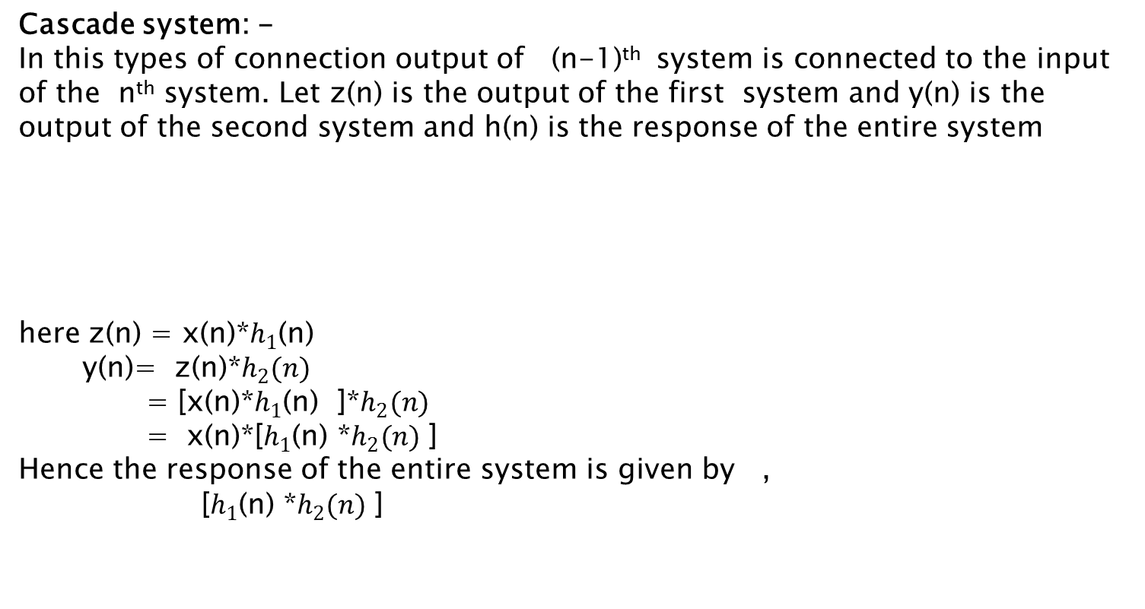
Discuss the connection of LTI System
Cascade system: -
In this types of connection output of (n-1)^{th} system is connected to the input of the n^{th} system. Let z(n) is the output of the first system and y(n) is the output of the second system and h(n) is the response of the entire system
here z(n) = x(n)*$h_{1}$(n)
y(n)= z(n)*$h_{2}(n)$
= [x(n)*$h_{1}$(n) ]*$h_{2}(n)$
= x(n)*[$h_{1}$(n) *$h_{2}(n)$ ]
Hence the response of the entire system is given by ,
[$h_{1}$(n) *$h_{2}(n)$ ]

Slide 39
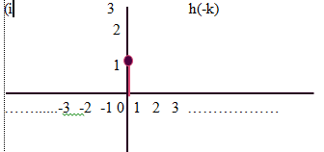
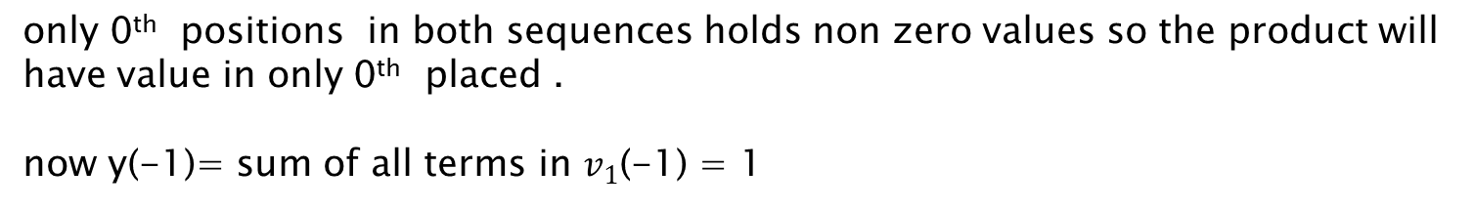
Discuss the connection of LTI System
Parallel system:-
In this types of connections each system produces individual output .and finally the are added and the output of entire system is generated.
Step 6:- shift to right h(1-k) by 1 to get h(2-k)
only 0th positions in both sequences holds non zero values so the product will have value in only 0th placed .
now y(-1)= sum of all terms in $v_{1}$(-1) = 1

Slide 40
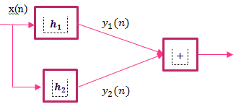
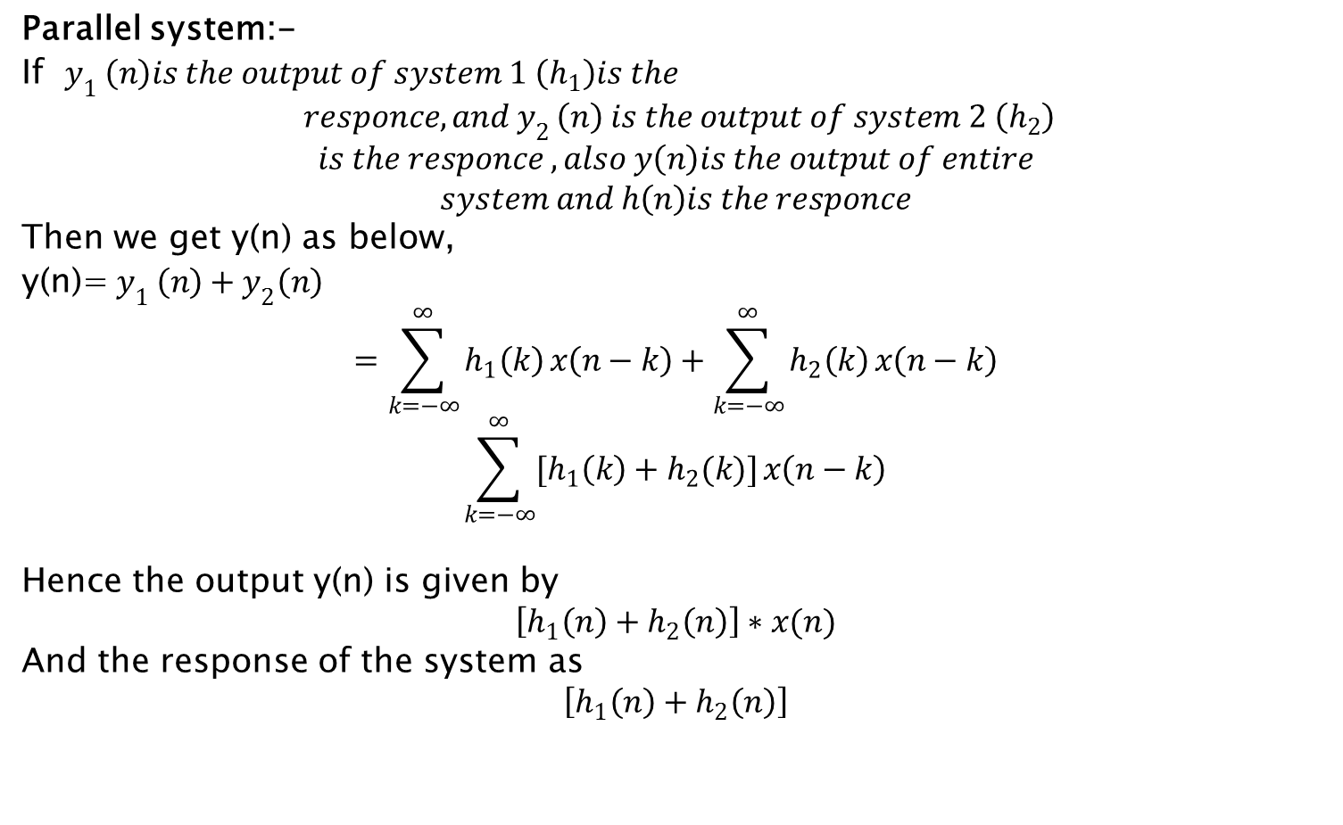
Discuss the connection of LTI System
Parallel system:-
If $y_{1 }\left(n\right)is the output of system 1 \left(h_{1}\right)is the$
$$responce, and y_{2 }\left(n\right) is the output of system 2 \left(h_{2}\right)$$
$$is the responce ,also y\left(n\right)is the output of entire$$
$$system and h\left(n\right)is the responce$$
Then we get y(n) as below,
y(n)=$y_{1 }\left(n\right)+y_{2}\left(n\right)$
$$=\sum_{k=−∞}^{∞}{h_{1}\left(k\right)}x\left(n−k\right)+\sum_{k=−∞}^{∞}{h_{2}\left(k\right)}x\left(n−k\right)$$
$$\sum_{k=−∞}^{∞}{[h_{1}\left(k\right)+h_{2}(k)]}x\left(n−k\right)$$
Hence the output y(n) is given by
$$\left[h_{1}\left(n\right)+h_{2}\left(n\right)\right]∗x(n)$$
And the response of the system as
$$\left[h_{1}\left(n\right)+h_{2}\left(n\right)\right]$$

Slide 41
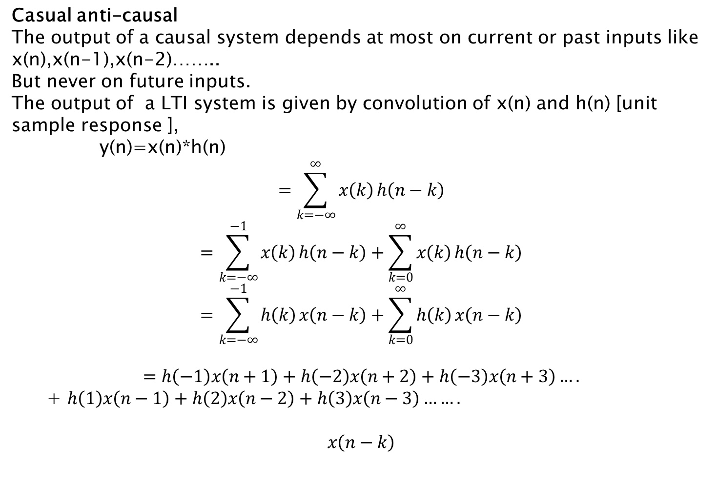
Types of LTI System ?
Casual anti-causal
The output of a causal system depends at most on current or past inputs like x(n),x(n-1),x(n-2)……..
But never on future inputs.
The output of a LTI system is given by convolution of x(n) and h(n) [unit sample response ],
y(n)=x(n)*h(n)
$$=\sum_{k=−∞}^{∞}{x\left(k\right)}h\left(n−k\right)$$
$$=\sum_{k=−∞}^{−1}{x\left(k\right)}h\left(n−k\right)+\sum_{k=0}^{∞}{x\left(k\right)}h\left(n−k\right)$$
$$=\sum_{k=−∞}^{−1}{h\left(k\right)}x\left(n−k\right)+\sum_{k=0}^{∞}{h\left(k\right)}x\left(n−k\right)$$
$$=h\left(−1\right)x\left(n+1\right)+h\left(−2\right)x\left(n+2\right)+h\left(−3\right)x\left(n+3\right)….$$
+ $h\left(1\right)x\left(n−1\right)+h\left(2\right)x\left(n−2\right)+h\left(3\right)x\left(n−3\right)…….$
$$x\left(n−k\right)$$

Slide 42
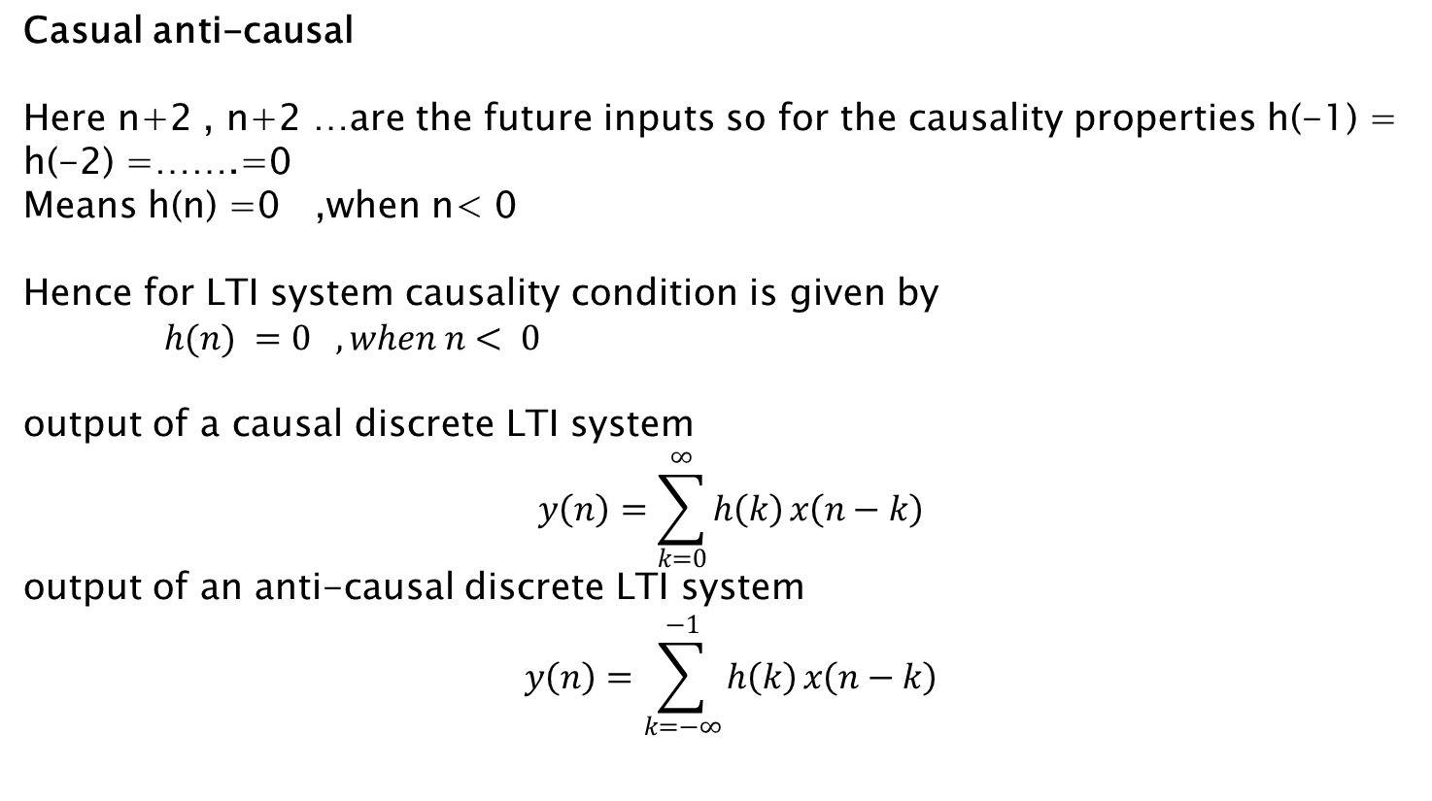
Types of LTI System ?
Casual anti-causal
Here n+2 , n+2 …are the future inputs so for the causality properties h(-1) = h(-2) =…….=0
Means h(n) =0 ,when n< 0
Hence for LTI system causality condition is given by
$h(n) =0 ,when n< 0$
output of a causal discrete LTI system
$$y\left(n\right)=\sum_{k=0}^{∞}{h\left(k\right)}x\left(n−k\right)$$
output of an anti-causal discrete LTI system
$$y\left(n\right)=\sum_{k=−∞}^{−1}{h\left(k\right)}x\left(n−k\right)$$

Slide 43
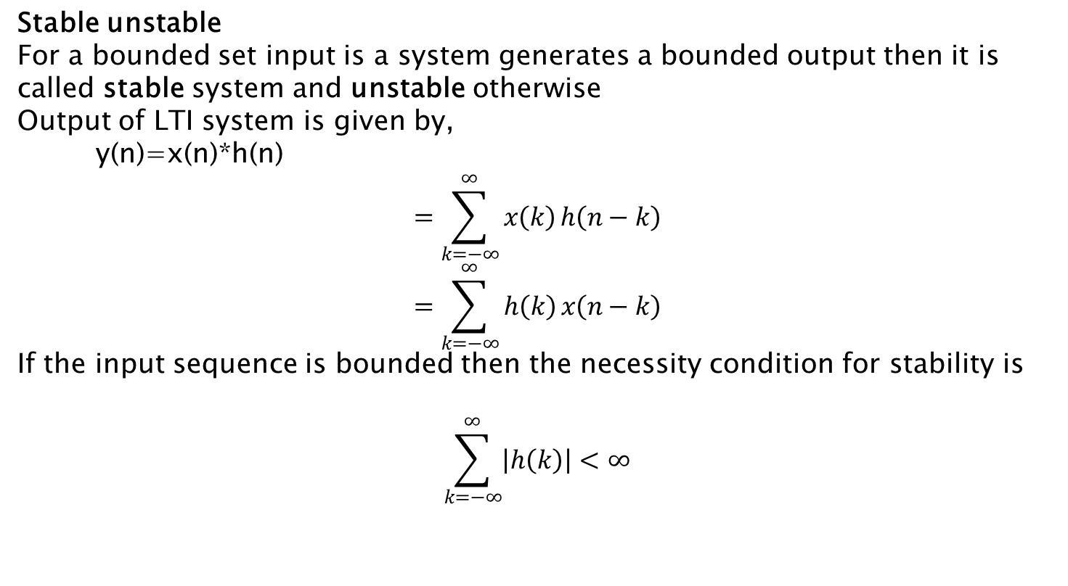
Types of LTI System ?
Stable unstable
For a bounded set input is a system generates a bounded output then it is called stable system and unstable otherwise
Output of LTI system is given by,
y(n)=x(n)*h(n)
$$=\sum_{k=−∞}^{∞}{x\left(k\right)}h\left(n−k\right)$$
$$=\sum_{k=−∞}^{∞}{h\left(k\right)}x\left(n−k\right)$$
If the input sequence is bounded then the necessity condition for stability is
$$\sum_{k=−∞}^{∞}{\left|h\left(k\right)\right|<∞}$$

Slide 44
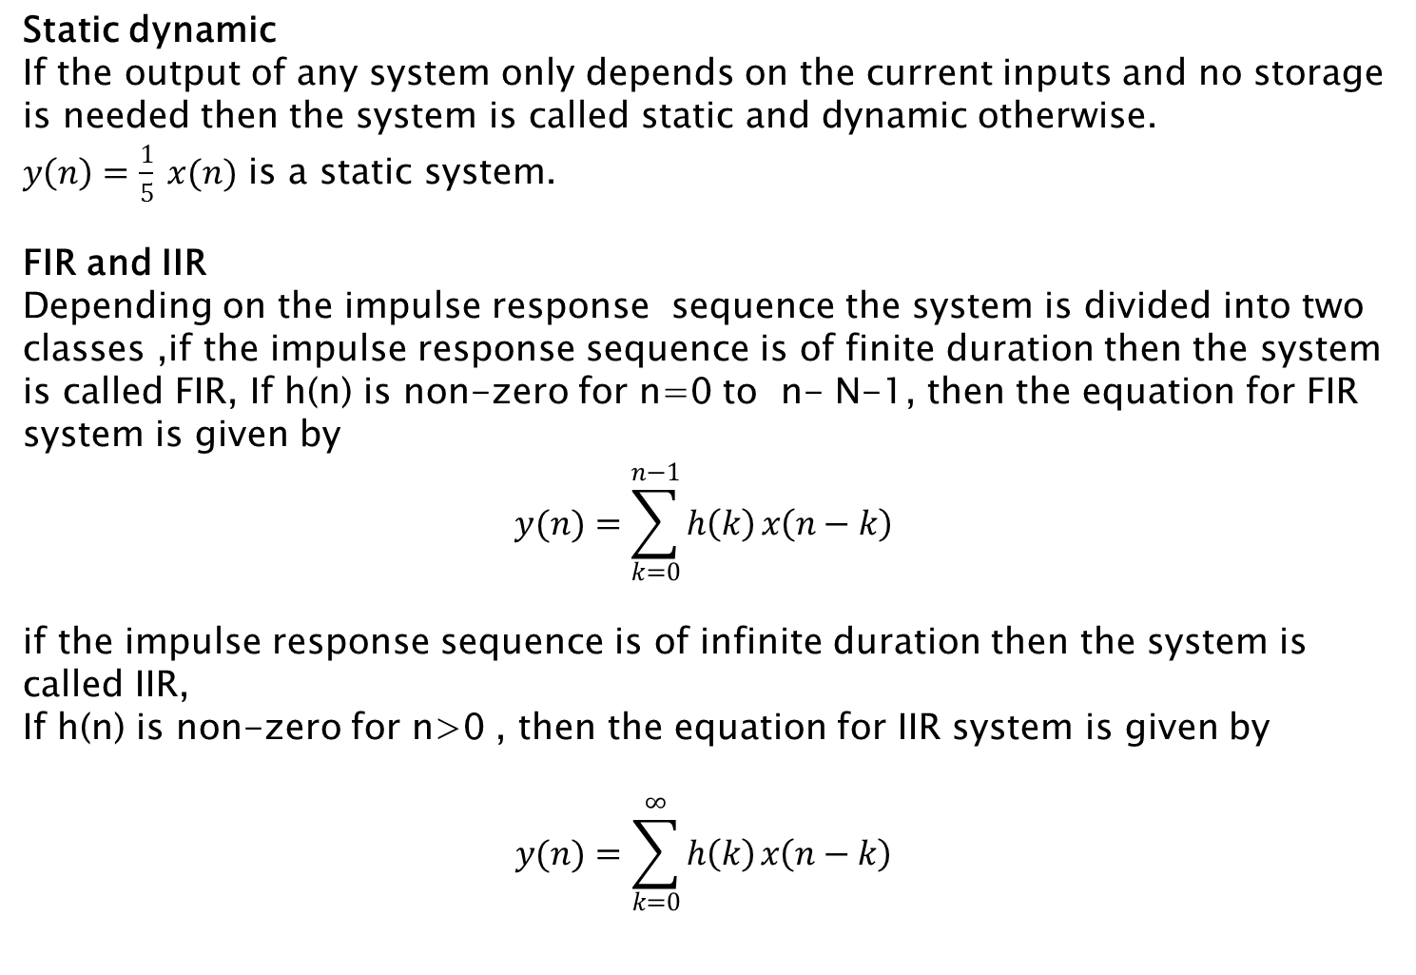
Types of LTI System ?
Static dynamic
If the output of any system only depends on the current inputs and no storage is needed then the system is called static and dynamic otherwise.
$y\left(n\right)=\frac{1}{5} x(n)$ is a static system.
FIR and IIR
Depending on the impulse response sequence the system is divided into two classes ,if the impulse response sequence is of finite duration then the system is called FIR, If h(n) is non-zero for n=0 to n- N-1, then the equation for FIR system is given by
$$y(n)=\sum_{k=0}^{n−1}{h\left(k\right)}x\left(n−k\right)$$
if the impulse response sequence is of infinite duration then the system is called IIR,
If h(n) is non-zero for n>0 , then the equation for IIR system is given by
$$y(n)=\sum_{k=0}^{∞}{h\left(k\right)}x\left(n−k\right)$$

Slide 45
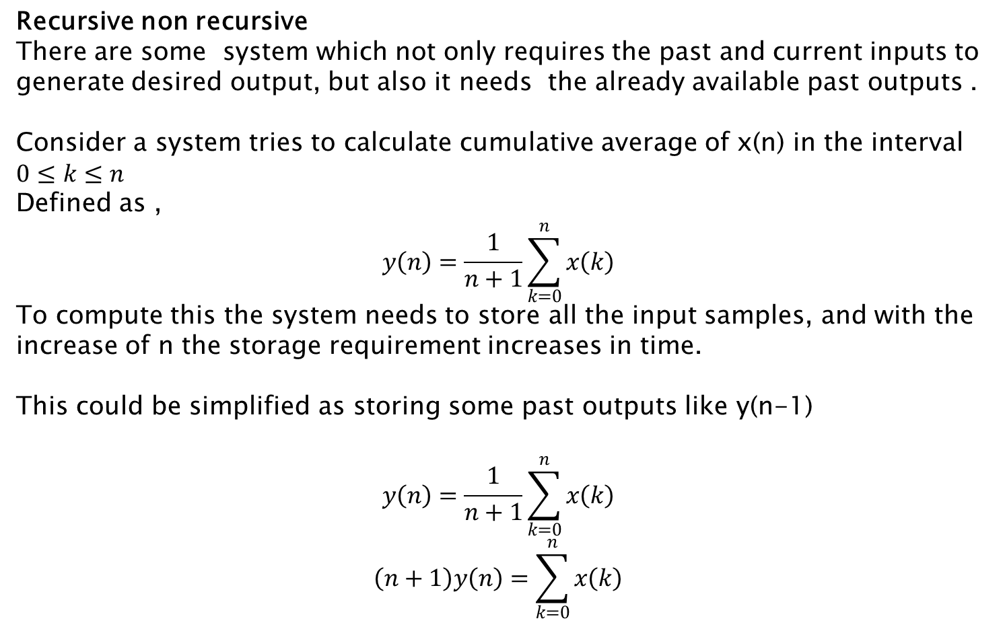
Types of LTI System ?
Recursive non recursive
There are some system which not only requires the past and current inputs to generate desired output, but also it needs the already available past outputs .
Consider a system tries to calculate cumulative average of x(n) in the interval $0≤k≤n$
Defined as ,
$$y\left(n\right)=\frac{1}{n+1}\sum_{k=0}^{n}{x\left(k\right)}$$
To compute this the system needs to store all the input samples, and with the increase of n the storage requirement increases in time.
This could be simplified as storing some past outputs like y(n-1)
$$y\left(n\right)=\frac{1}{n+1}\sum_{k=0}^{n}{x\left(k\right)}$$
$$\left(n+1\right)y\left(n\right)=\sum_{k=0}^{n}{x\left(k\right)}$$

Slide 46
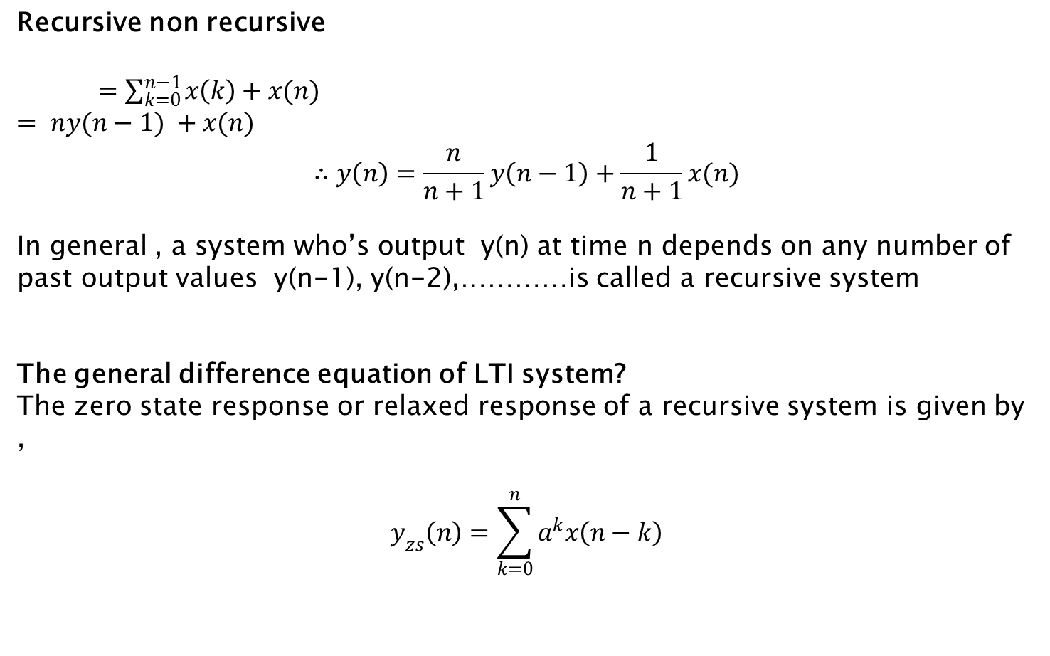
Types of LTI System ?
Recursive non recursive
$=\sum_{k=0}^{n−1}{x\left(k\right)}+x(n)$
$= ny(n−1) +x(n)$
$$∴y\left(n\right)=\frac{n}{n+1}y\left(n−1\right)+\frac{1}{n+1}x(n)$$
In general , a system who’s output y(n) at time n depends on any number of past output values y(n-1), y(n-2),…………is called a recursive system
The general difference equation of LTI system?
The zero state response or relaxed response of a recursive system is given by ,
$$y_{zs}\left(n\right)=\sum_{k=0}^{n}{a^{k}x\left(n−k\right)}$$

Slide 47
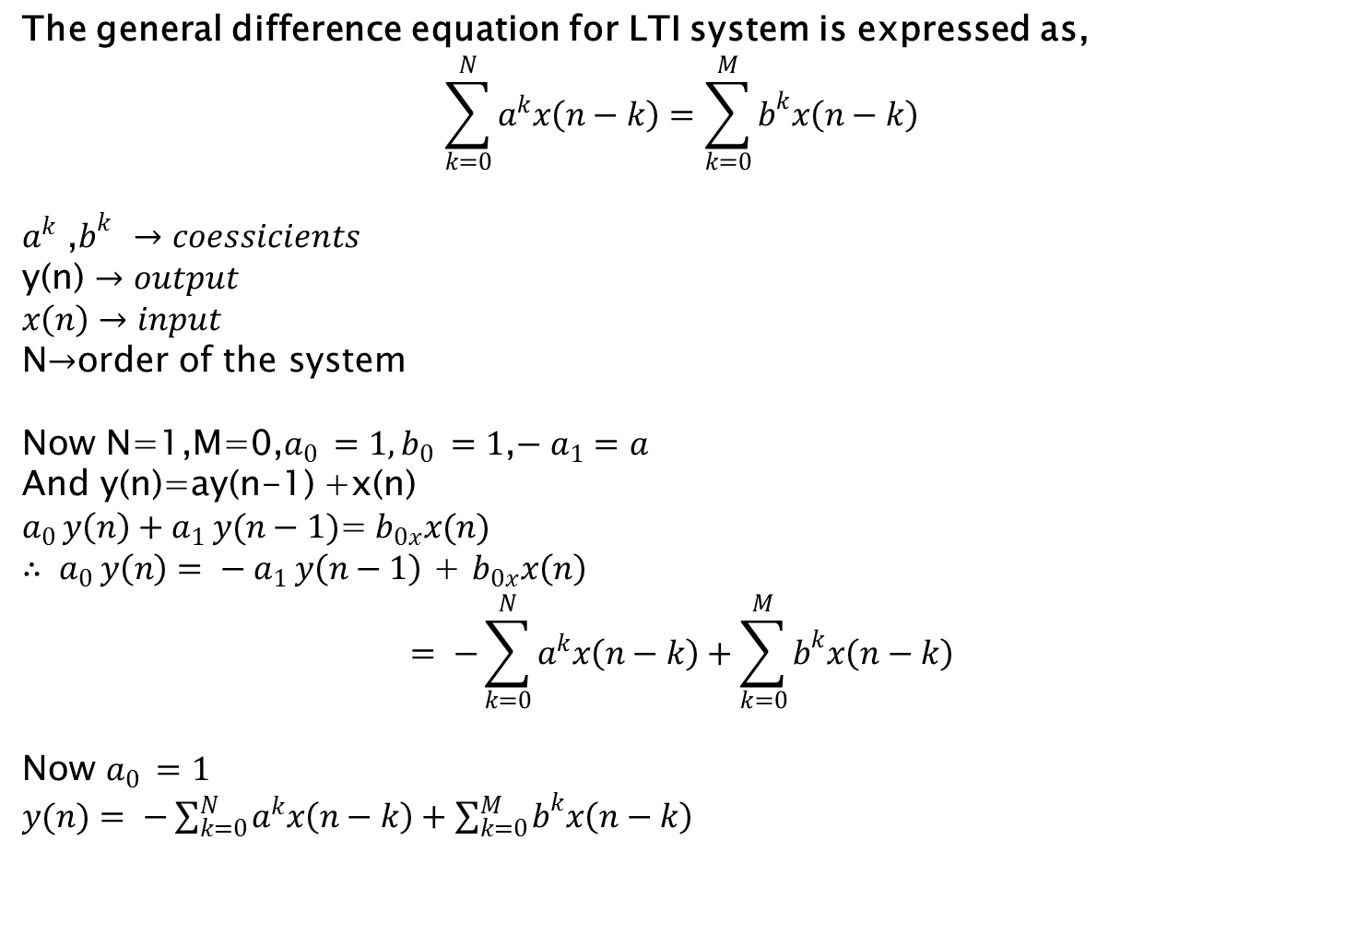
Types of LTI System ?
The general difference equation for LTI system is expressed as,
$$\sum_{k=0}^{N}{a^{k}x\left(n−k\right)}=\sum_{k=0}^{M}{b^{k}x\left(n−k\right)}$$
$a^{k}$ ,$b^{k }→coessicients$
y(n) $→output$
$x\left(n\right)→input$
N$→$order of the system
Now N=1,M=0,$a_{0 }=1,b_{0 }=1$,$− a_{1}=a$
And y(n)=ay(n-1) +x(n)
$a_{0 }y\left(n\right)+a_{1 }y(n−1)$=$b_{0x}x(n)$
$∴ a_{0 }y\left(n\right)= − a_{1 }y\left(n−1\right)$ + $b_{0x}x\left(n\right)$
$$= −\sum_{k=0}^{N}{a^{k}x\left(n−k\right)}+\sum_{k=0}^{M}{b^{k}x\left(n−k\right)}$$
Now $a_{0 }=1$
$y(n)= −\sum_{k=0}^{N}{a^{k}x\left(n−k\right)}+\sum_{k=0}^{M}{b^{k}x\left(n−k\right)}$

Slide 48
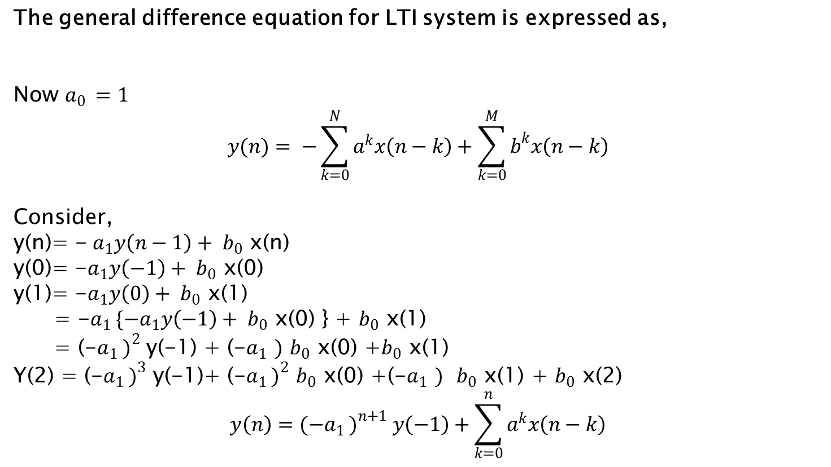
Types of LTI System ?
The general difference equation for LTI system is expressed as,
Now $a_{0 }=1$
$$y(n)= −\sum_{k=0}^{N}{a^{k}x\left(n−k\right)}+\sum_{k=0}^{M}{b^{k}x\left(n−k\right)}$$
Consider,
y(n)= -$a_{1}y\left(n−1\right)+ b_{0 }$x(n)
y(0)= -$a_{1}y\left(−1\right)+ b_{0 }$x(0)
y(1)= -$a_{1}y\left(0\right)+ b_{0 }$x(1)
= -$a_{1 }\{{−a}_{1}y\left(−1\right)+ b_{0 }$x(0) } + $b_{0 }$x(1)
= (-${a_{1 })}^{2}$ y(-1) + (-$a_{1 })$ $b_{0 }$x(0) +$b_{0 }$x(1)
Y(2) = (-${a_{1 })}^{3}$ y(-1)+ (-${a_{1 })}^{2}$ $b_{0 }$x(0) +(-$a_{1 })$ $b_{0 }$x(1) + $b_{0 }$x(2)
$$y\left(n\right)=(−{a_{1 })}^{n+1} y\left(−1\right)+\sum_{k=0}^{n}{a^{k}x\left(n−k\right)}$$

Slide 49
Correlation
Correlation addresses the question: “to what degree is signal A similar to signal B.”
An intuitive answer can be developed by comparing deterministic signals with stochastic signals.
Deterministic = a predictable signal equivalent to that produced by a mathematical function
Stochastic = an unpredictable signal equivalent to that produced by a random process

Slide 50
Correlation
Correlation is maximum when
Two signals are similar in shape
And are in phase (or unshifted)
Correlation is measure of similarity between two signals as a function of time shift between them

Slide 51
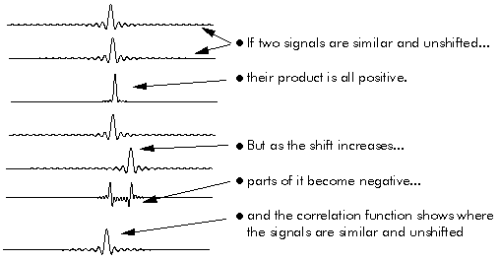
Correlation
Correlation functions shows how similar two signals are, and how long they remain similar when one is shifted with respect to the other

Slide 52
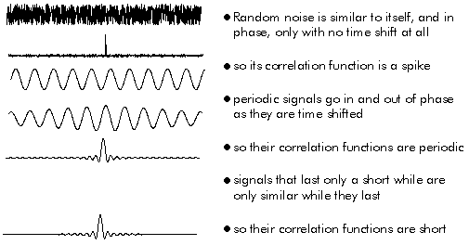
Autocorrelation
Correlating a signal with itself

Slide 53
Xcorrelation to identify a signal
Cross-correlation of x(n) and y(n) is a sequence, r_{xy}(l)

Slide 54
Thanks for your attention

